Slide 1
Connectivity An analysis for fNIRS data with groups
Tyson S. Barrett, PhD

Slide 2
Why something new?
Effect sizes are important
Intuitive interpretation is important
Usability is important
Flexibility is important
Reproducibility is important
Linear mixed effects models are cool

Slide 3
What is connectivity?
A “recipe” based approach
Uses linear mixed effect models in a form similar to Granger-Causality models
Outcome ~ lag(Outcome) + predictors + (1 | participant)
Output is in terms of standardized effect sizes that are similar to correlations
Allows comparisons of groups

Slide 4
How to use?
Three steps:
Import
Analyze
Visualize
github.com/TysonStanley/connectivity

Slide 5
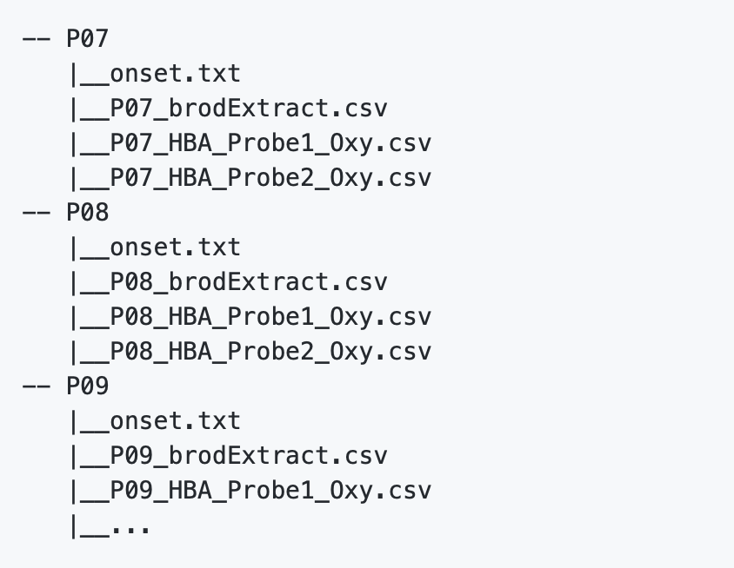
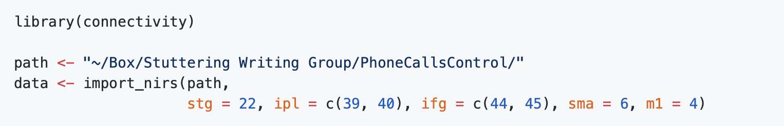
Import
Currently this is the messiest step and will likely be improved over time

Slide 6
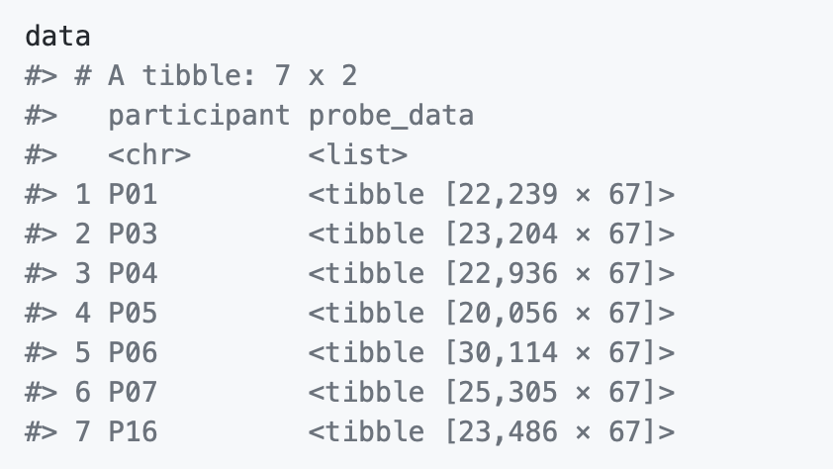
Import
Gives you data that looks like this

Slide 7
Import
Gives you data that looks like this
Contains all the data for P01 (including the averages for each region defined above)

Slide 8
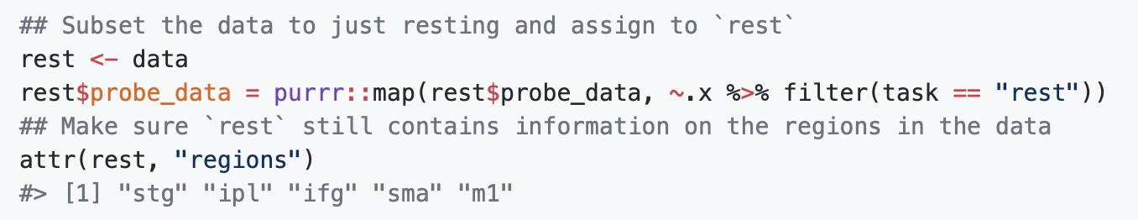
Import
To grab just one of the tasks

Slide 9
Import
To grab just one of the tasks
The data should have an attribute called “regions” that has all the regions of interest (this code is how you check)

Slide 10
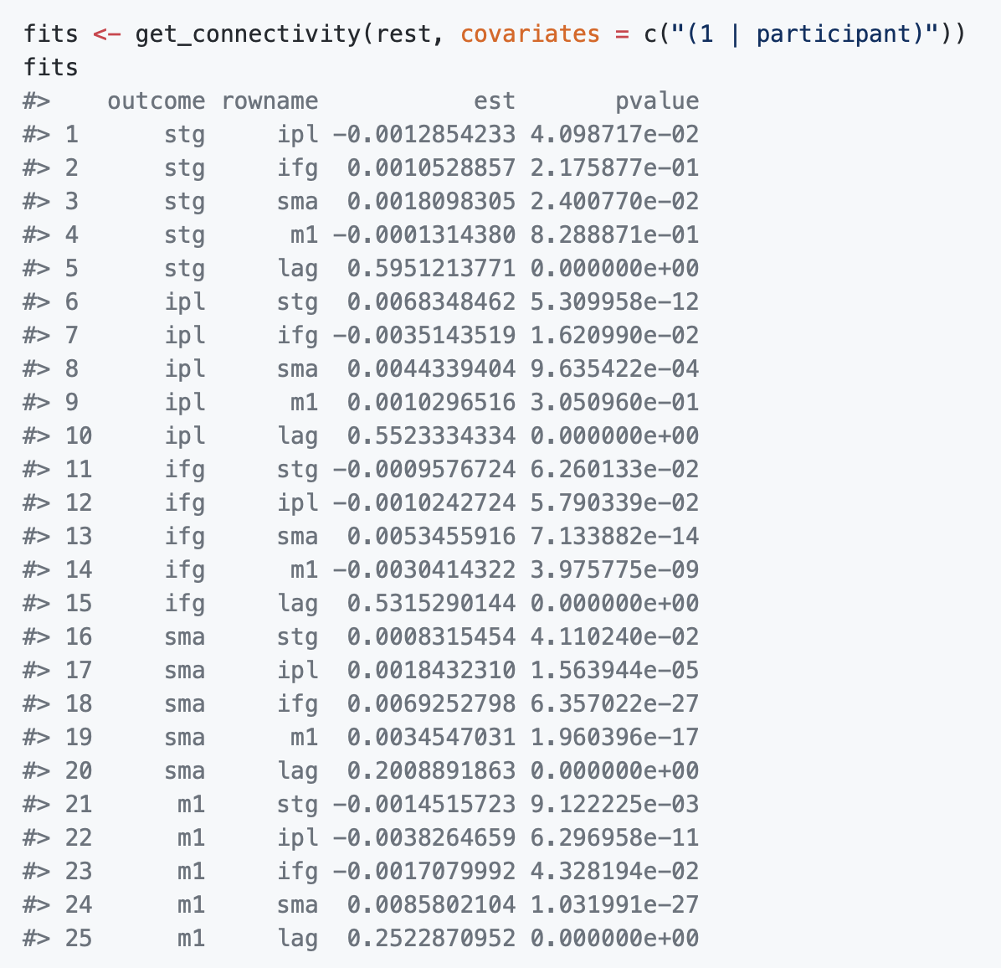
Analyze
This will run a series of linear mixed effects models, with each region as the outcome predicted by its lag and the regions (plus anything you put in the “covariates”)
“est” is the effect size estimate and “pvalue” is the pvalue (using Satterthwaite approximation to degrees of freedom)

Slide 11
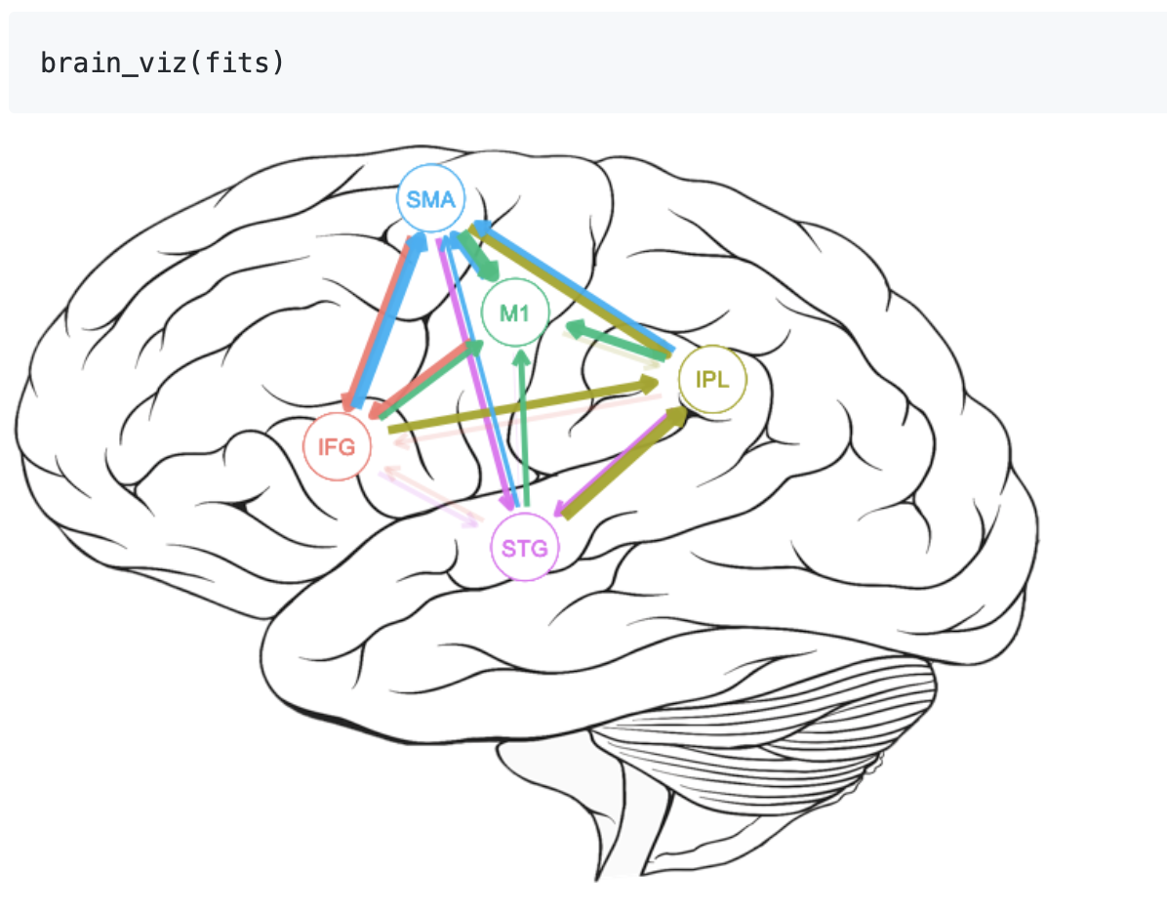
Visualize
The brain_viz() function will plot the effect sizes (size of arrows) and pvalue (transparent is not significant at .05)
Can control all elements of the visual (the image, where the circles are, etc.)

